Slide 1
webtext.tech 🌎
Democratizing the web

Slide 2
45%
of the world’s population does not have access to high-speed internet.*
Notes:
Here’s the problem: *according to the World Economic Forum, about 45% of the world’s population does not have access to high speed internet, yet the free acquisition of knowledge and sharing of experiences is more tantamount to humanity today than ever before.

Slide 3
Most websites are heavy, clunky, and cluttered. 🗑
Notes:
Most websites are heavy, clunky, and cluttered. While sites with tons of assets and moving parts look fancy to many, these pages become massive unresponsive bottlenecks for individuals without access to robust broadband infrastructure. Furthermore, these kinds of sites can be difficult to host in nations with limited access low-cost server space. Individuals who don’t have access to high-speed internet deserve the right to enjoy a speedy, lightweight web.

Slide 4
We had an idea💡
Notes:
So we had an idea; what if anyone could create and access a low cost, lightweight, and low-latency webpage with minimal coding knowledge?

Slide 5
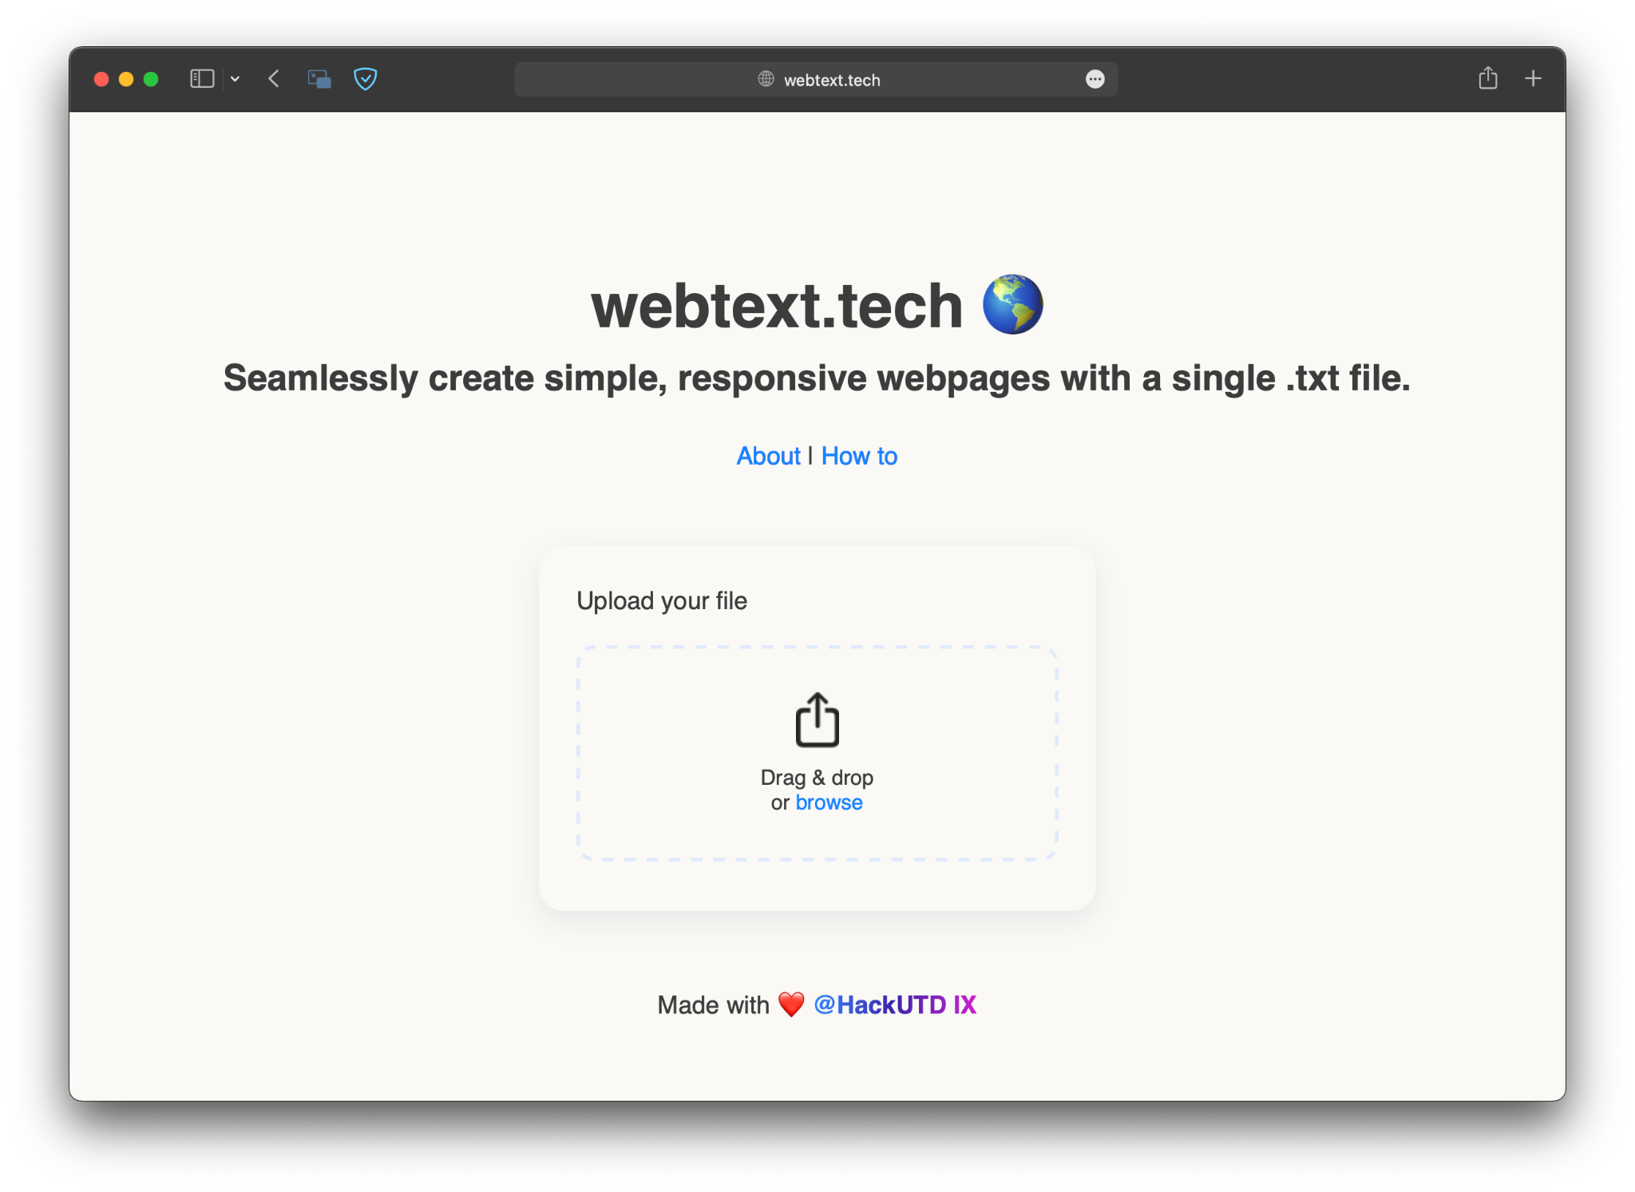
Notes:
Enter webtext.tech. Our mission is to remove as many barriers to free internet access as possible by offering a minimalist, elegantly designed, no-code web solution. We reject the notion of over-the-top, overweight webpages and embrace a minimalist design ethos which is accessible to anyone, regardless of their ability to code.

Slide 6
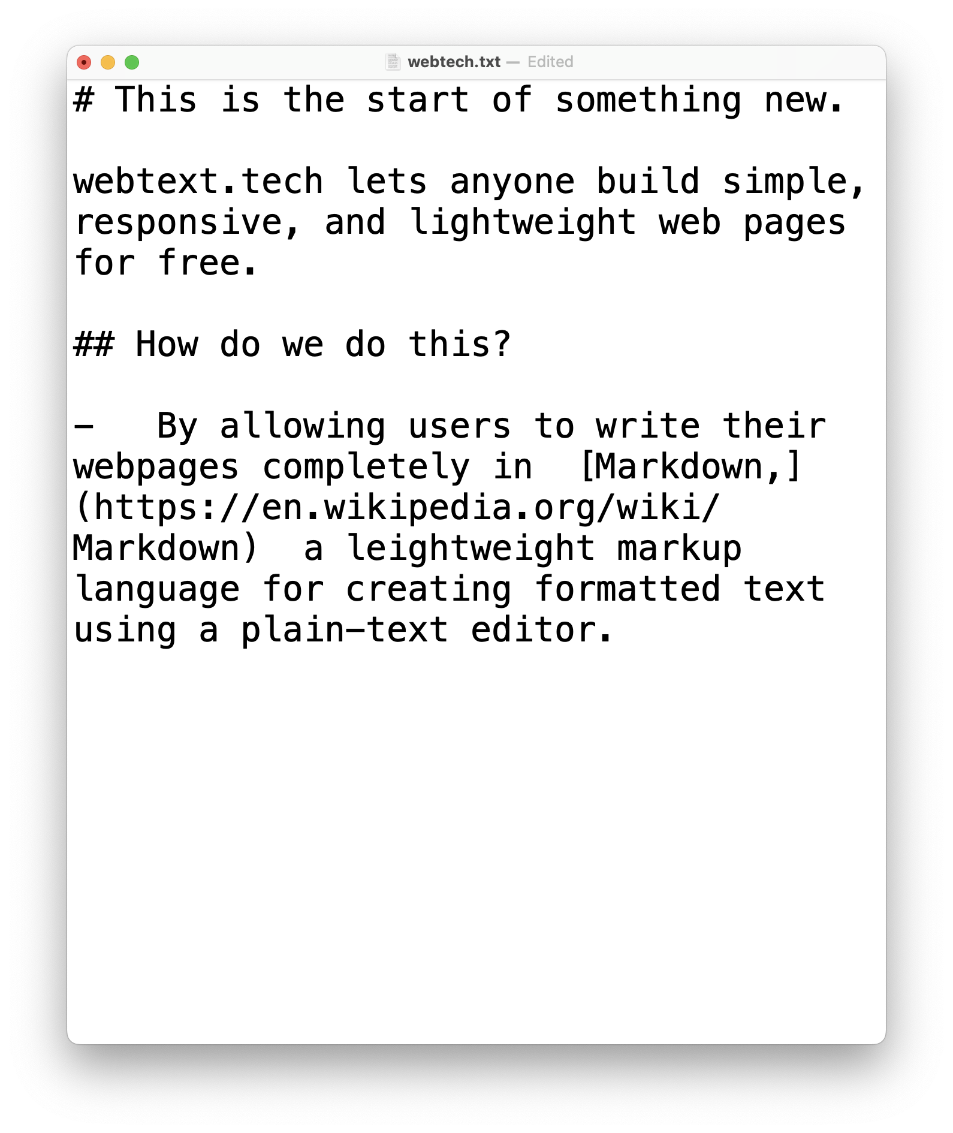
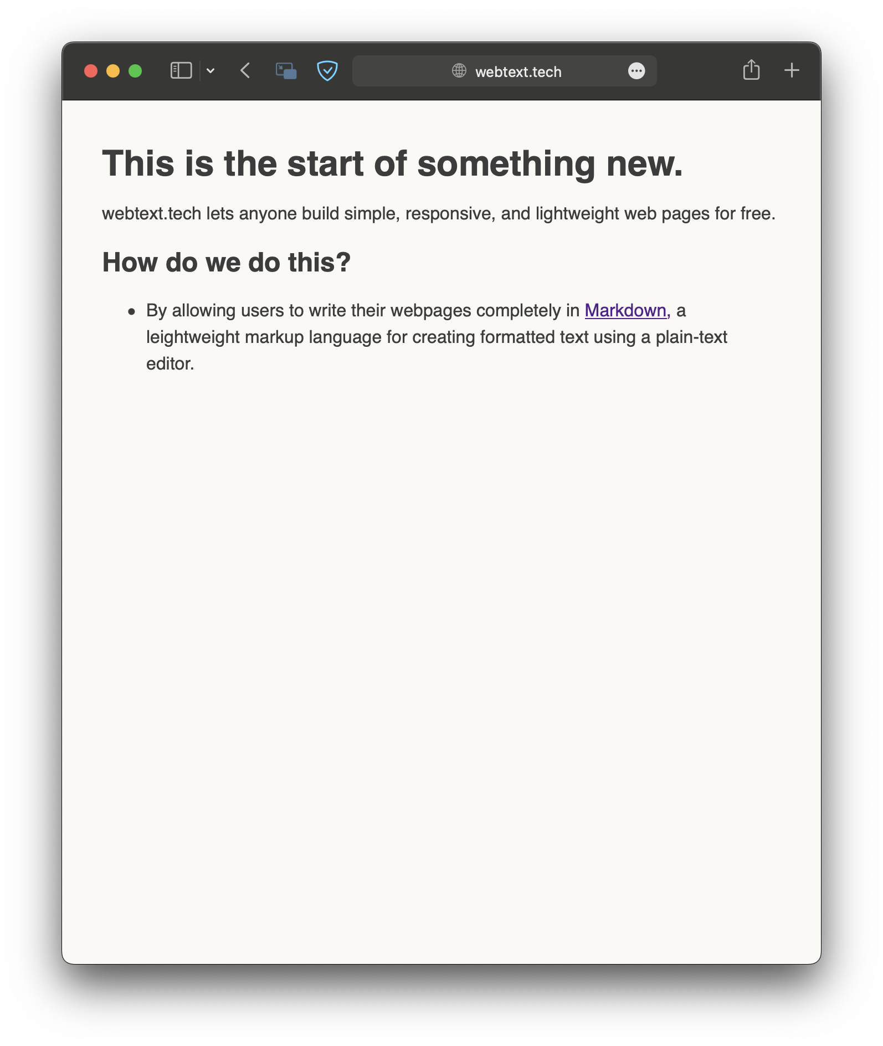
How it works
➡️
Notes:
Webtext.tech converts plain-text files formatted completely in Markdown, a leightweight markup language for creating formatted text using a plain-text editor, into stylized HTML. The user can then download the webpages generated and host them on the hosting service of their choice.

Slide 7
Business Model 💼
UX
Users who are seeking to develop their websites will find our innovative conversion service easy to use and risk-free.
Our webpage provides users instructions on how to upload their web documentation clearly.
webtext.tech links references for users who need further explanation on specific webpage parameters.
+
Service
webtext.tech is a no-code web service.
Utilizes HTML and CSS.
Completely ad-free, always. We are not seeking a profit from our user base.
=
Outcome
Users will be able to produce their websites passively and easily, all for free.
Our mission is to afford developers and users the right to speedy internet access and low barriers to entry to web development so that they can access the web without inhibition.

Slide 8
What’s next? 🔮
Notes:
Make custom URL’s for their webpage.
Edit an uploaded webpage on our site.
Host their webpage on our site before being published on a public domain.
Submit multiple files in a single upload.
Provide a User feedback feature for our users on the website.

